Slide 1
EDA Report on Bank Data
By Rakesh Pawar

Slide 2
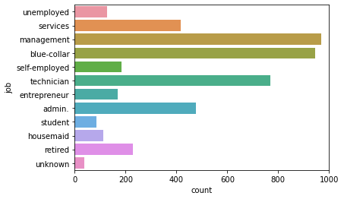
Bank Ac.Holder Stats

Slide 3
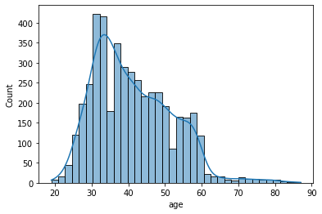
Client Age Group

Slide 4
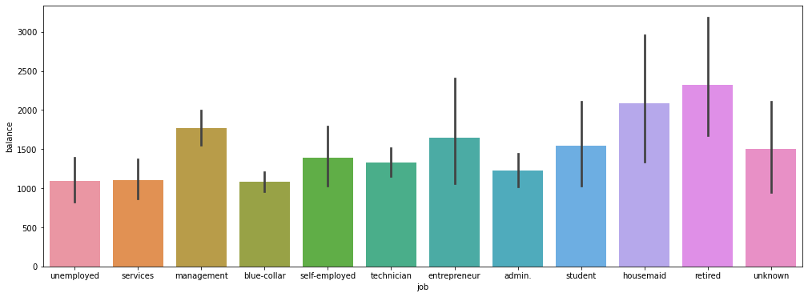
Bank Users Job profiles

Slide 5
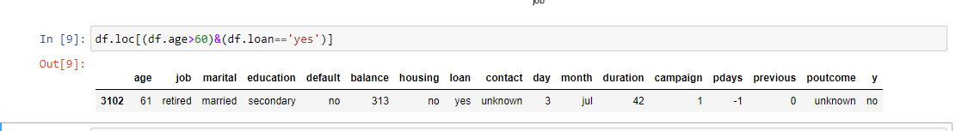



Slide 6
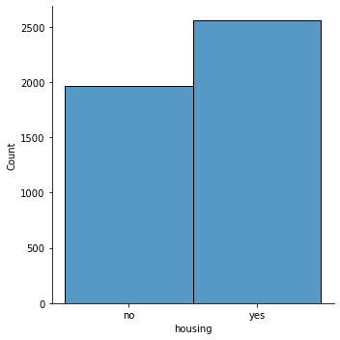
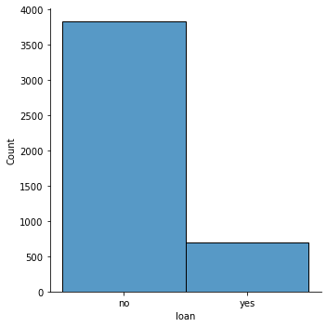
Housing Loan Vs Personal Loan

Slide 7


Housing Loan
Out of 4521 Bank Clients
2559 have Housing Loan
Which is 56.60%
NO
Yes

Slide 8
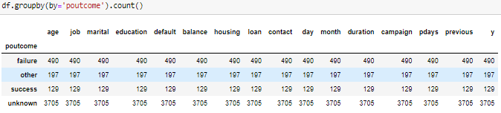
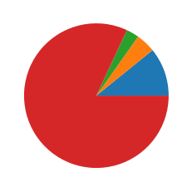
Campaign Overall Data
Success
Others
Failure
Unknown

Slide 9

Suggestion
1.Age group between 29-60 years old have Housing loan
2.63.5% are married loan holders
3.Most of the campaign are not reaching to end users as per DATA
4.I will also Suggest my Sales team to Advertise about Our Schemes in densely populated area of the city in Peak hours like
Public transports,FM ,TV ads sets

Slide 10


